Slide 1

Tableau Data
Diabetes Care Analysis:
Trends in Medication, Hospitalization, and Insulin Usage
Sep 2024 | Sadia Ayoub

Slide 2

Introduction
An exploratory data analysis of healthcare metrics across various demographics
Sep 2024 | Sadia Ayoub

Slide 3

Motivation
Why i choose this data set for data analysis?
Sep 2024 | Sadia Ayoub

Slide 4

Data Source
Dataset: Diabetes 130-US hospitals for years 1999-2008.
Contains 50 columns including patient demographics, medical conditions, medications, and hospital stay details.
Publicly available from UCI Machine Learning Repository.
Sep 2024 | Sadia Ayoub

Slide 5

Time in Hospital

Slide 6
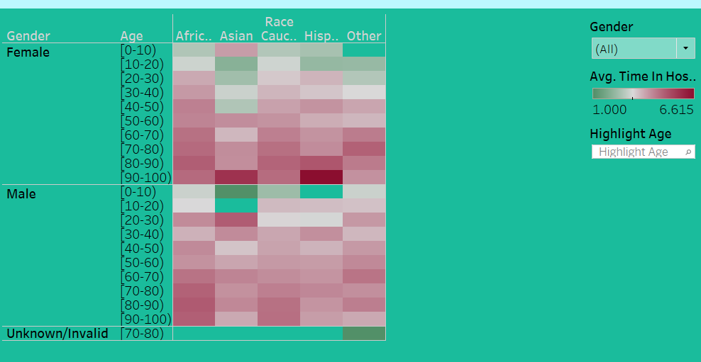

Slide 7
Time in Hospital
Dataset: Diabetes 130-US hospitals for years 1999-2008.
Contains 50 columns including patient demographics, medical conditions, medications, and hospital stay details.
Publicly available from UCI Machine Learning Repository.
Sep 2024 | Sadia Ayoub

Slide 8
Medication(by age)

Slide 9
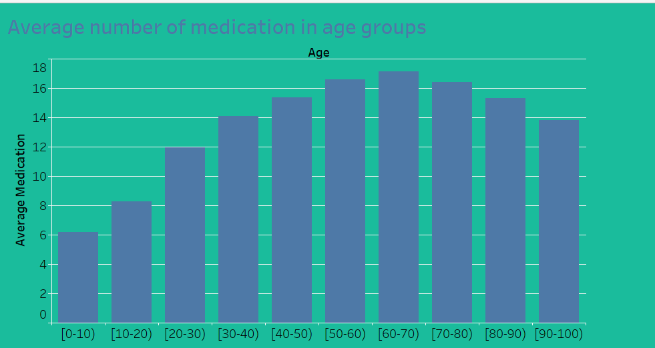

Slide 10

Medication(by age)
This sheet examines how the number of medications prescribed varies across different age groups.
A key observation here is that as age increases, the number of medications tends to rise.
Due to various chronic old diseases such as diabetes
Sep 2024 | Sadia Ayoub

Slide 11
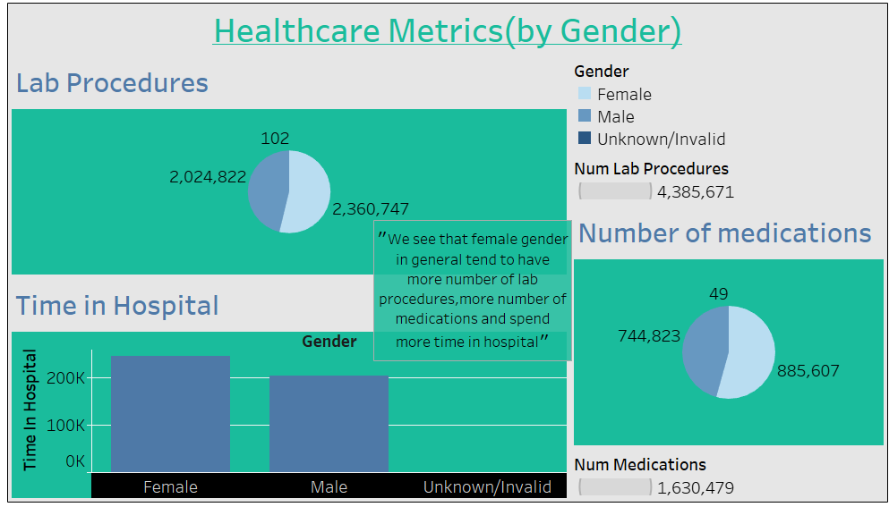
HealthCare Metrics(by gender)

Slide 12
Diagnosis(per Race)

Slide 13
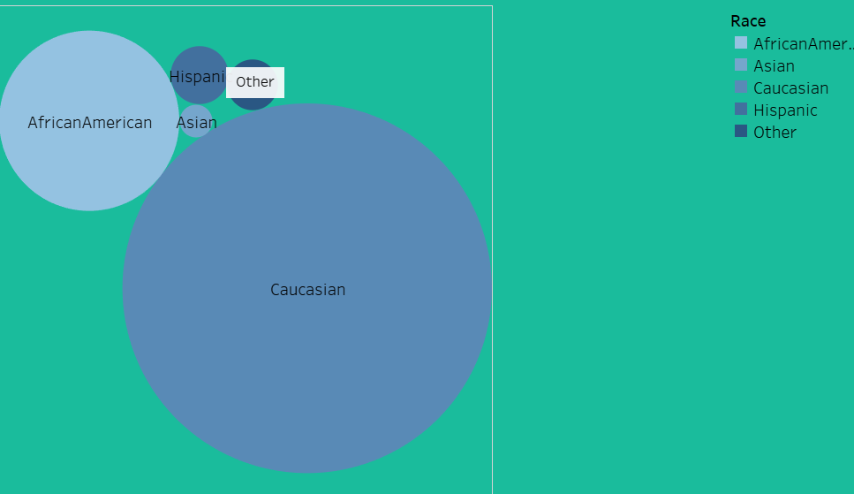

Slide 14

Diagnosis(per Race)
Caucasian race has the highest number of diagnosis in the dataset.
1) Maximum number of inpatient for caucasian race is in the age group 20-30
2) Maximum number of outpatients for caucasian race is in the age group 80-90
3) Maximum number of emergency patients for caucasian race is in the age group 60-70
Sep 2024 | Sadia Ayoub

Slide 15
Diagnosis(Caucasian)

Slide 16
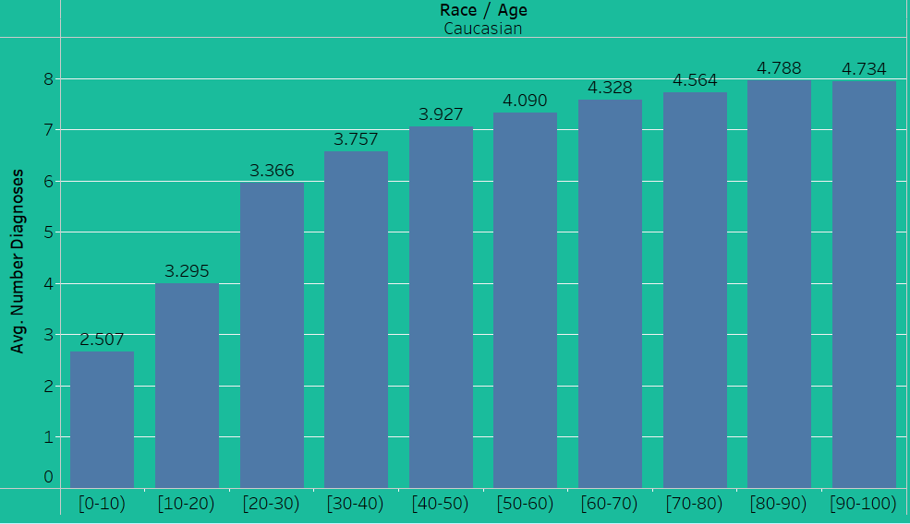

Slide 17

Diagnosis(Caucasias)
Caucasian race has the highest number of diagnosis in the dataset.
1) Maximum number of inpatient for caucasian race is in the age group 20-30
2) Maximum number of outpatients for caucasian race is in the age group 80-90
3) Maximum number of emergency patients for caucasian race is in the age group 60-70
Sep 2024 | Sadia Ayoub

Slide 18
Insulin Dosage(sr.citizen)

Slide 19
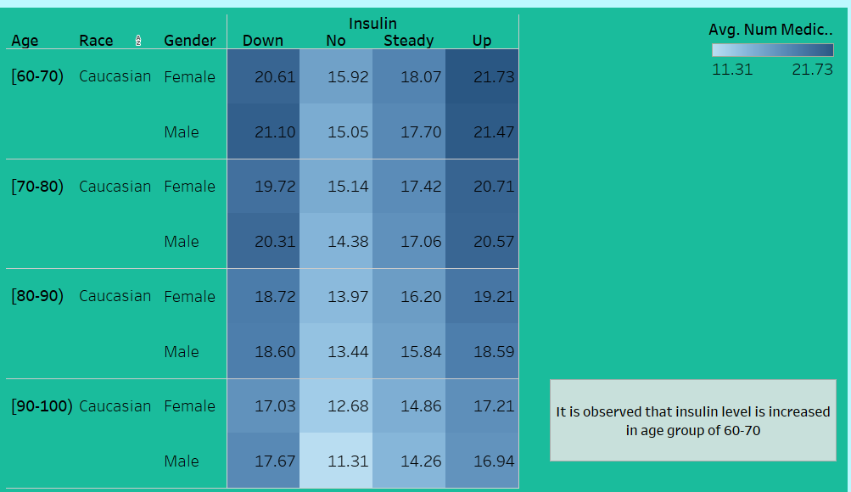

Slide 20

Conclusion
Patients with diabetes tend to have significantly longer hospital stays.
Age, race, and number of procedures also impact hospital stay duration.
Age increases, the number of medications tends to rise.
Insights can help healthcare providers develop targeted interventions to improve patient outcomes and hospital efficiency.
Sep 2024 | Project Report

Slide 21

Any Questions!

Slide 22

Thank you

